Slide 1
Regression Analysis
Model Selection
Nicoleta Serban, Ph.D.
Professor
Stewart School of Industrial and Systems Engineering
Regularized Regression: Approaches

Slide 2

About This Lesson

Slide 3
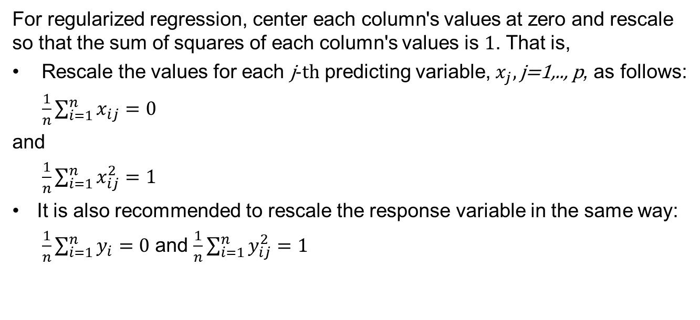
Variable Standardization & Notation
For regularized regression, center each column's values at zero and rescale so that the sum of squares of each column's values is 1. That is,
Rescale the values for each j-th predicting variable, $x_{j},$ j=1,.., p, as follows:
$\frac{1}{n}\sum_{i=1}^{n}{x_{ij}=0}$
and
$\frac{1}{n}\sum_{i=1}^{n}{x_{ij}^{2}=1}$
It is also recommended to rescale the response variable in the same way:
$\frac{1}{n}\sum_{i=1}^{n}{y_{i}=0}$ and $\frac{1}{n}\sum_{i=1}^{n}{y_{ij}^{2}=1}$
➔ Use the original scale when fitting the selected model for interpretation of the regression coefficients.

Slide 4
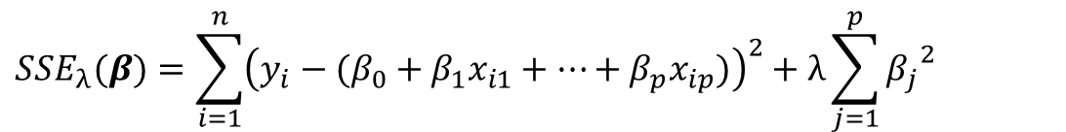
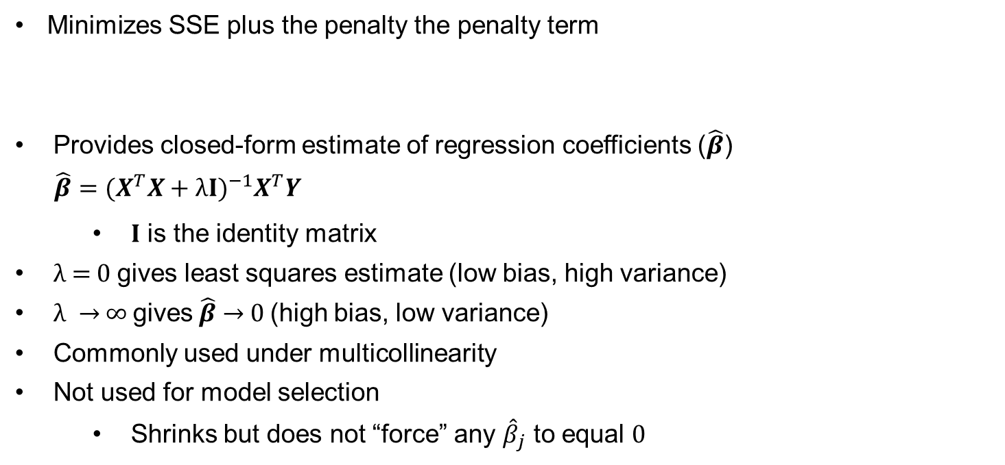
Ridge Regression
Minimizes SSE plus the penalty the penalty term
Provides closed-form estimate of regression coefficients ($\hat{β}$)
$$\hat{β}={(X^{T}X+λI)}^{−1}X^{T}Y$$
  $I$ is the identity matrix
$λ$= 0 gives least squares estimate (low bias, high variance)
$λ →$ ∞ gives$\hat{β}$ $→$0 (high bias, low variance)
Commonly used under multicollinearity
Not used for model selection
  Shrinks but does not “force” any ${\hat{β}}_{j}$ to equal 0
$$SSE_{λ}(β)=\sum_{i=1}^{n}{{\left(y_{i}−(β_{0}+β_{1}x_{i1}+⋯+β_{p}x_{ip})\right)}^{2}}+λ\sum_{j=1}^{p}{{β_{j}}^{2}}$$

Slide 5
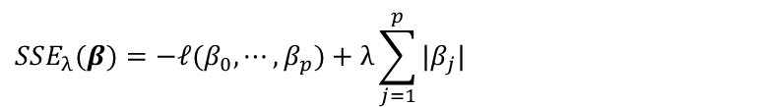
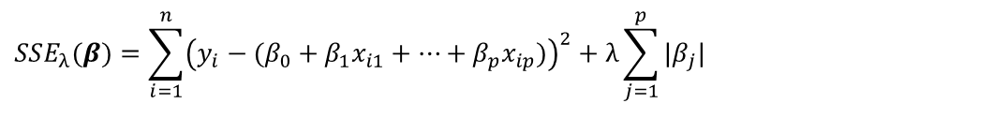
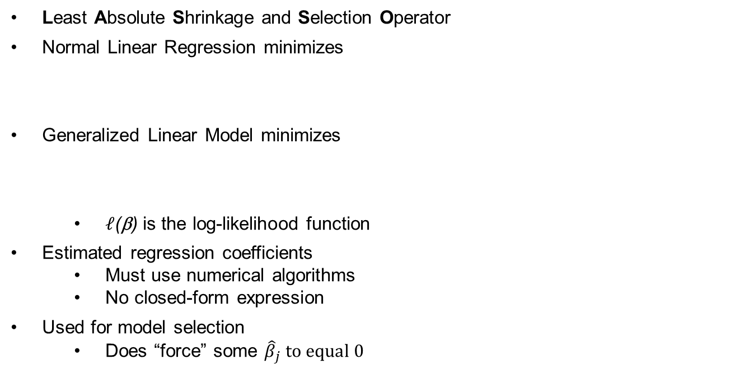
LASSO Regression
Least Absolute Shrinkage and Selection Operator
Normal Linear Regression minimizes
Generalized Linear Model minimizes
  $ℓ$(β) is the log-likelihood function
Estimated regression coefficients
  Must use numerical algorithms
  No closed-form expression
Used for model selection
  Does “force” some ${\hat{β}}_{j} to equal 0$
$$SSE_{λ}(β)=\sum_{i=1}^{n}{{\left(y_{i}−(β_{0}+β_{1}x_{i1}+⋯+β_{p}x_{ip})\right)}^{2}}+λ\sum_{j=1}^{p}{|β_{j}|}$$
$$SSE_{λ}(β)=−ℓ(β_{0},⋯,β_{p})+λ\sum_{j=1}^{p}{|β_{j}|}$$

Slide 6
LASSO Regression
Least Absolute Shrinkage and Selection Operator
Normal Linear Regression minimizes
Generalized Linear Model minimizes
  $ℓ$(β) is the log-likelihood function
Estimated regression coefficients
  Must use numerical algorithms
  No closed-form expression
Used for model selection
  Does “force” some ${\hat{β}}_{j} to equal 0$
LASSO performs estimation of regression coefficients and variable selection simultaneously.
The regression coefficients obtained from LASSO are less efficient than those obtained from Ordinary Least Squares (OLS).
After using LASSO to select the model, use OLS to estimate the (final) regression coefficients.
$$SSE_{λ}(β)=\sum_{i=1}^{n}{{\left(y_{i}−(β_{0}+β_{1}x_{i1}+⋯+β_{p}x_{ip})\right)}^{2}}+λ\sum_{j=1}^{p}{|β_{j}|}$$
$$SSE_{λ}(β)=−ℓ(β_{0},⋯,β_{p})+λ\sum_{j=1}^{p}{|β_{j}|}$$

Slide 7
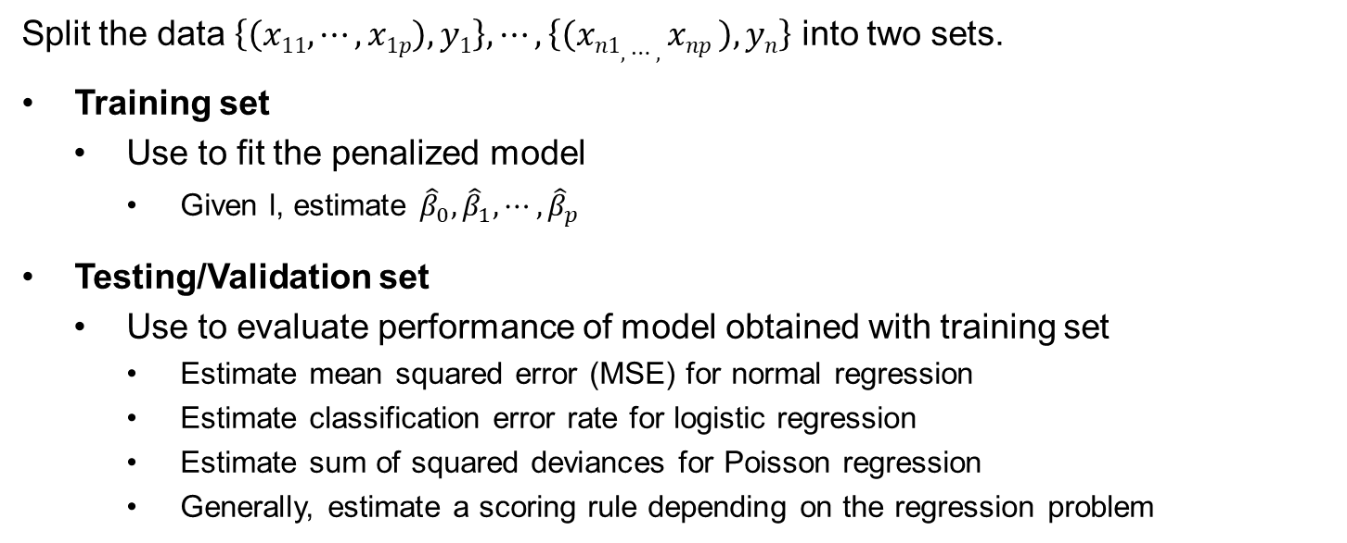
Choosing λ: Cross-Validation
Split the data $\left\{\left(x11,⋯, x1p\right), y1\right\},⋯,\left\{\left(xn1,⋯, xnp \right), yn\right\}$ into two sets.
Training set
  Use to fit the penalized model
    Given l, estimate ${\hat{β}}_{0}, {\hat{β}}_{1},⋯, {\hat{β}}_{p}$
Testing/Validation set
  Use to evaluate performance of model obtained with training set
    Estimate mean squared error (MSE) for normal regression
    Estimate classification error rate for logistic regression
    Estimate sum of squared deviances for Poisson regression
    Generally, estimate a scoring rule depending on the regression problem
The process can be repeated for multiple λs.

Slide 8
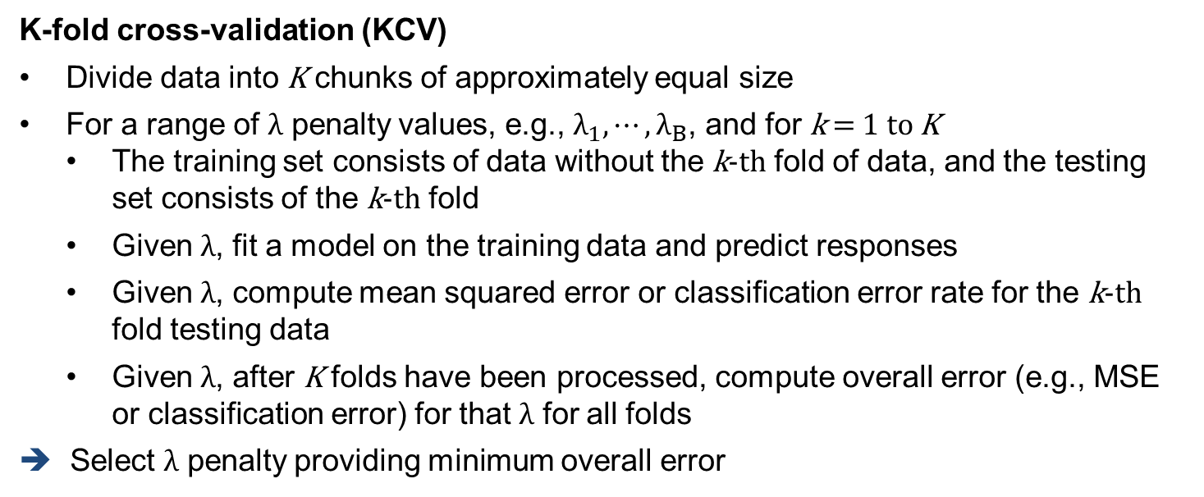
Cross Validation: How to Split Data?
K-fold cross-validation (KCV)
Divide data into K chunks of approximately equal size
For a range of $λ$ penalty values, e.g., $λ_{1},⋯,λ_{B}$, and for k = 1 to K
  The training set consists of data without the k-th fold of data, and the testing set consists of the k-th fold
  Given $λ$, fit a model on the training data and predict responses
  Given $λ$, compute mean squared error or classification error rate for the k-th fold testing data
  Given $λ$, after K folds have been processed, compute overall error (e.g., MSE or classification error) for that $λ$ for all folds
➔ Select $λ$ penalty providing minimum overall error

Slide 9
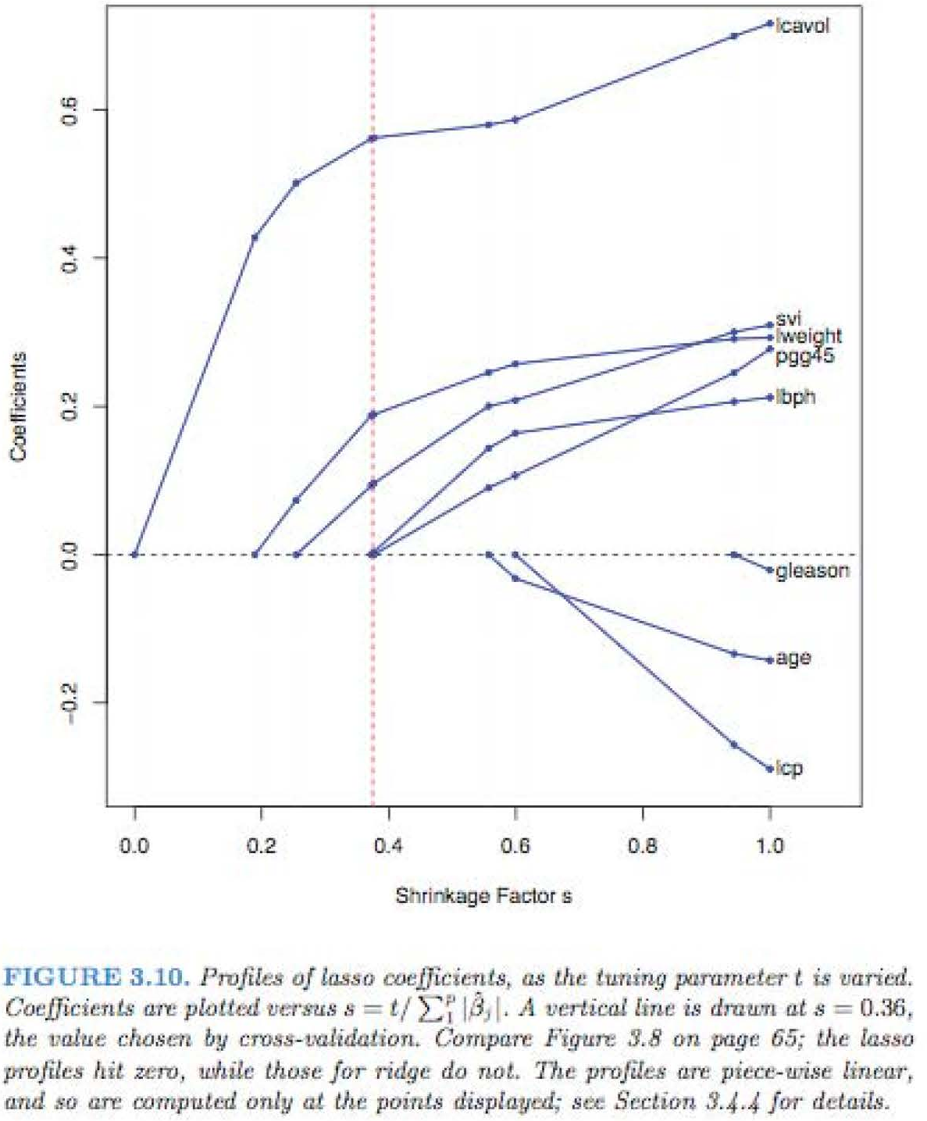
Ridge vs. LASSO Regression
Acknowledgement: From Hastie, T., Tibshirani, R., Friedman, J. (2001), The Elements of Statistical Learning, Springer Series in Statistics.

Slide 10
LASSO: Limitations
LASSO selects only up to n variables
  n is the number of observations
  If the number of potential predictors is greater than the number of observations, LASSO will select at most n of them
  Since, normally, n > p, not a significant limitation
If there are high correlations among predictors
  LASSO is dominated by ridge regression
If there is a group of variables with high correlation
  LASSO tends to select only one variable from the group
    LASSO doesn't care which one

Slide 11
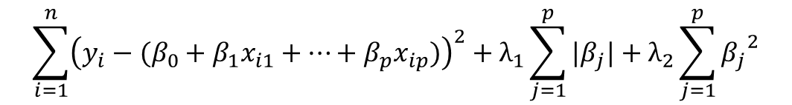
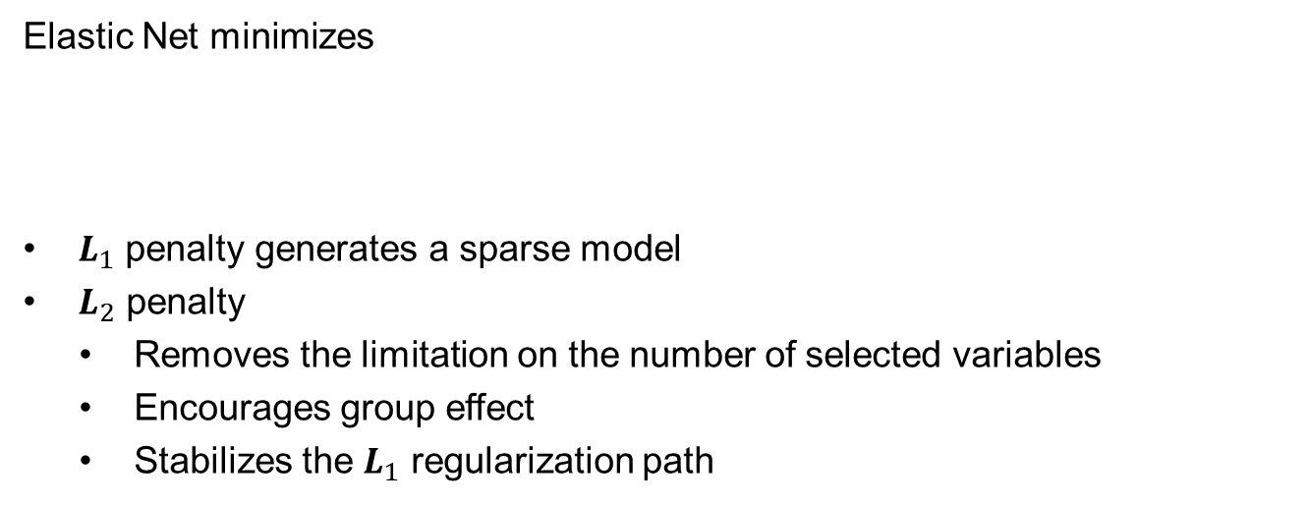
Elastic Net
Elastic Net minimizes
$L_{1}$ penalty generates a sparse model
$L_{2}$ penalty
  Removes the limitation on the number of selected variables
  Encourages group effect
  Stabilizes the $L_{1}$ regularization path
$$\sum_{i=1}^{n}{{\left(y_{i}−(β_{0}+β_{1}x_{i1}+⋯+β_{p}x_{ip})\right)}^{2}}+λ_{1}\sum_{j=1}^{p}{|β_{j}|+λ_{2}\sum_{j=1}^{p}{{β_{j}}^{2}}}$$
Reference: Hui Zou and Trevor Hastie. "Regularization and variable selection via the elastic net." Journal of the Royal Statistical Society: Series B 67.2 (2005): 301-320.

Slide 12

Summary

